Slide 1

Cat in a Box scenario
Playbook to optimize Cyber security incident response For box Manufacturing
- Max security inc-

Slide 2
Introduction
The purpose of this presentation is to unveil our collaborative efforts to optimize incident response plan equipping Box Manufacturing with the appropriate tools and strategies to detect, respond and mitigate cybersecurity threats. The following presentation will assume a basic understanding of threats such a Ransomware and Phishing and will not go in length about explaining what they are. However, references will be present at the end of this presentation.

Slide 3
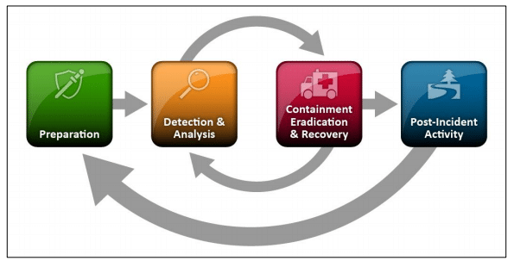
Nist Incident Response Plan for Box Manufacturing
https://www.securitymetrics.com/blog/6-phases-incident-response-plan

Slide 4
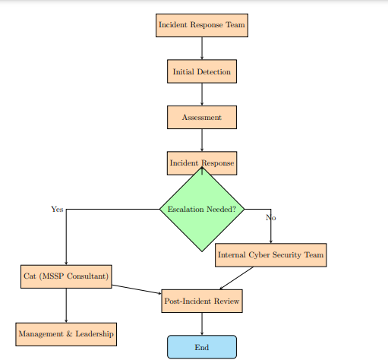
Box Company Incident response Flowchart

Slide 5
Incident response procedure
Preparation: This step includes contingency, data gathering processes and identifying the key players to reach out to if a threat is suspected or confirmed.
Detection: Determining the nature of the incident, it’s severity and the attack vector. Escalate the to a more experience or senior SOC if need be. (or in our case a third party)
Containment/Eradication: Measures that will be put in place to contain and/or eliminate the threat. We will have few examples in this presentation.
Recovery: Bring the system to its previous condition before the threat
Things to learn: It is important to learn from each threat or attacks so that it does not happen again.

Slide 6
Nist Incident Response Plan for Box Manufacturing
Purpose of the incident response : The goal is to minimize the damage of an attack, protect the asset and ensure an optimal response for cybersecurity incidents
Applicability: This plan has been built taking into consideration the request, but also the financial limitation and the staff limitation considering that the client does not have in-house capabilities to handle a breach everything will be sent to a third party.
Roles and responsibilities
Percy (percy@box.cat): Contact for escalation, urgent matters or unresolved issues after 48 hours
-Misha (misha@box.cat): Primary contact and Works 9-17 AST Monday to Friday
-Minka (minka@box.cat): Alternate contact and covers after hours and weekend support
- Cat (cat@soc.cat)3rd party: Works for MSSP and is responsible for security oversight

Slide 7
Trigger Items that may affect the workflow
Time and Date: Rigorous auditing and monitoring greatly help promptly to contain and eliminate a threat
Severity and Impact: The higher the severity the more attention it requires (ex: an issues affecting one staff member vs 500 employees)
The target: If the threat affect a critical asset it needs to be contained as soon as possible and the matter has to be resolved in a timely matter
Attack Type and Tactics: It is important to identify the type of attack to allocate the proper strategy and the proper threat level associate to the threat
More items exists and have not been enumerated in that presentation. Only the relevant ones related to the company likely threats have been identified. The following slides will mention two treats (and incident responses) that are likely to happen to the box company and to cause damage if they occur. Those threats are phishing and ransomware. This presentation will not go into exhaustive explanation of the threats nature and will assume basic knowledge on them from the reader.

Slide 8
Phishing incident response (pt1)
Preparation
Education and training/ Simulate phishing campaign and feedback to employees/Email filtering/etc.
Detection
Ongoing incident will be detected through employees revealing that they have disclosed sensitive information to an unauthorized person, through an unfamiliar email sources or unsolicited attachments.
Depending on the status of the impacted party the level of threat fluctuate (ex: Someone responsible for the finances vs a janitor’s account do not have the same level of threat for the company).
As a policy, if the threat targets staff members from finance department or any members from management, consider the threat as high, escalate it to Cat the MSSP and SOC Security Oversight and attend to it immediately. If the target is anyone other than the above-mentioned departments treat it a as medium. In the latter situation the escalation would be at the staff’s discretion.

Slide 9
Phishing incident response (pt2)
Containment/Eradication
Contain the threat by changing access to the person or people affected. If it is an email, mark it as spam and block the sender
Alert all the employees about a potential threat
Recovery and things to learn
Before considering the system has “restored”, make sure to scan the network to verify that the threat is gone.
Have a shame free environment where people would be comfortable coming forward to tell you that they were victim of a phishing attack. Also, find out how the attack happened and create a training that includes the vector that was used by the attacker.
Make sure that your spam filter is working and if it is, try to adapt it to the current threat.
Industry Standards (MITRE ATT&CK Framework):
We integrate the MITRE ATT&CK Framework into our Phishing Incident Response. By understanding the adversary techniques involved in phishing attacks, we improve our ability to detect, respond, and mitigate phishing threats promptly.

Slide 10
Ransomware incident response (pt1)
Preparation
Conduct regular backup of the most valuable assets
Implement strong security measures such as firewalls and intrusion detection systems.
Detection
Keep as much evidence as possible (notes, screenshots, IP, etc). It may be useful for law enforcement
Ongoing incident will be detected by the attacker making demands based on information he/she has. The internal IT team has to contact MSSP consultant (Cat) who is responsible of security oversight and request MSSP expertise

Slide 11
Ransomware incident response (pt2)
Containment/ Eradication
Take immediate action to isolate the affected system(s). And prevent a spread of the malware (Implement Network segmentation if possible)
If any reason to believe that the safety of anyone is jeopardize, contact the authorities during the process
Recovery and things to learn
Analyse if a restoration of the system is possible and look for any backdoors first. A few of Anti-Malware programs can be installed to prevent the implementation or presence of such malwares.
Inform management and stakeholders of the situation. Indicate how it happened and what has been done to prevent the same incident in the future
Document the incident and use the situation has future training material
Industry Standards (MITRE ATT&CK Framework):
We adopt the MITRE ATT&CK Framework into our Ransomware Incident Response to optimize our response to Ransomware threats. By analyzing the attacker tactics, we enhance our detection and mitigation abilities making the response as swift as possible.

Slide 12
Conclusion
Cybersecurity incidents, such as ransomware and phishing attack pose a significant threat to indivuduals and organisations. Having a well-prepared incident response plan is paramount for effectively mitigating the impact of these attacks. Additionally, implementing frameworks like MITRE ATT&CK and having, a clear flowchart as well as identifying the items that may impact the workflow is crucial and will enhance the organization defensive capabilities.
We appreciate your trust, and we look forward to work alongside you.
Your Security is Our Priority

Slide 13
Contact information
Percy (Primary Contact)
Role: Contact for escalated, urgent, or unresolved issues after 48 hours.
Email: percy@box.cat
Phone (Daytime): 902 66-9999
Misha (Primary Contact)
Role: Works from 9 AM to 5 PM AST on weekdays.
Email: mesha@box.cat
Phone (Daytime): 902 66-9999
Minka F. (Alternate Contact)
Role: Covers after-hours and weekend support for Box Manufacturing.
Email: minka@box.cat
Phone (After-hours & Weekend): 902 99-9999
External MSSP & SOC Security Oversight (3rd party):
Cat (Primary Contact)
Role: Contact for MSSP & SOC Security Oversight matters.
Email: cat@soc.cat
Phone (Daytime): 902 88-1234
Cell (After-hours & Weekend): 902 77-4321

Slide 14
References
https://www.securitymetrics.com/blog/6-phases-incident-response-plan
https://www.exabeam.com/incident-response/incident-response-plan/
https://www.trellix.com/en-ca/security-awareness/cybersecurity/what-is-mitre-attack-framework.html
https://www.exabeam.com/explainers/mitre-attck/what-is-mitre-attck-an-explainer/
https://www.proofpoint.com/us/threat-reference/ransomware
https://www.ibm.com/topics/phishing

Slide 15

Thank You
Max Security Inc
Daguste_05@live.fr

